Slide 1
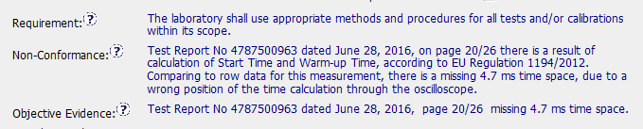
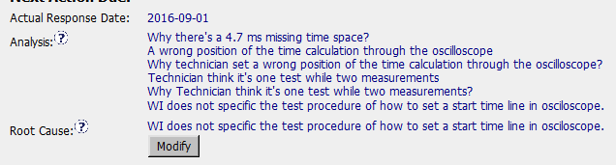
CAR 163916507 (observation)
Does the analysis support the Scope of Nonconformance statement?
Partial - Further information needed for analysis. Was the information recorded elsewhere (such as identified in raw data)?

Slide 2
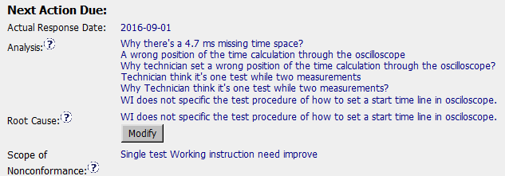
CAR 163916507 (observation)
Based upon the root cause, should the severity of the CAR be changed such that it should now be classified as a Finding?
Possibly - Without knowing further information of the mistake (deeper analysis), it looks to lead to a possible Finding. Previous projects should be reviewed for the missing information if the WI had to be updated to bridge the gap. Ensure future tests are being performed correctly.

Slide 3
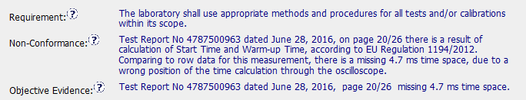
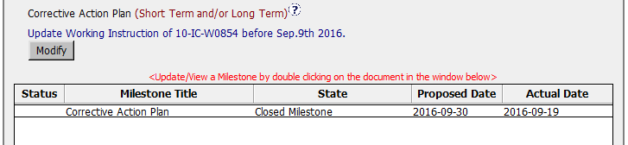
CAR 163916507 (observation)
Was the evidence in the milestones sufficient to confirm that the nonconformity was eliminated?
No – In an observation the objective evidence is to be corrected. In this case the test report mentioned in the objective evidence was not fixed. Milestone was not written appropriately.
Objective evidence was not fixed.

